Slide 1
Lecture 5
Data Warehouse Architecture

Slide 2
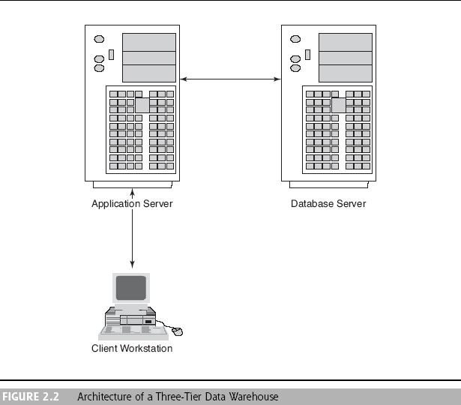
Data Warehousing Architectures

Slide 3
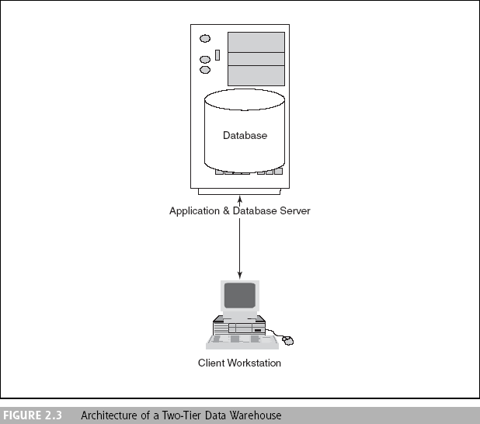
Data Warehousing Architectures

Slide 4
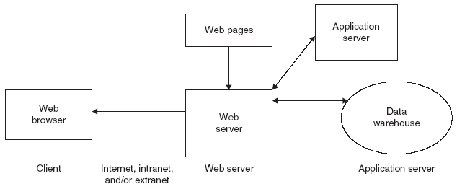
Web Based DW Architecture

Slide 5
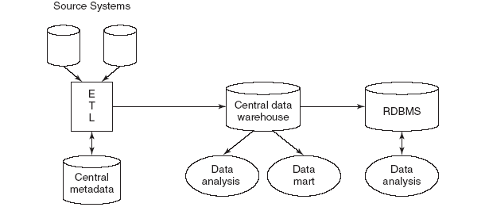
Enterprise DW Architecture

Slide 6
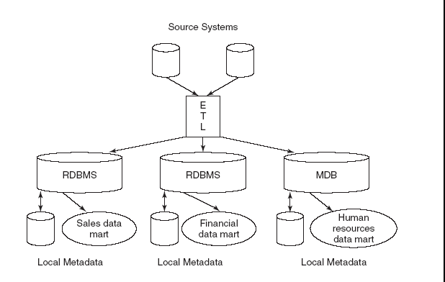
Data Mart Architecture

Slide 7
Data Warehousing Architectures
Ten factors that potentially affect the architecture selection decision:
Constraints on resources
Strategic view of the data warehouse prior to implementation
Compatibility with existing systems
Perceived ability of the in-house IT staff
Technical issues
Social/political factors
Information interdependence between organizational units
Upper management’s information needs
Urgency of need for a data warehouse
Nature of end-user tasks

Slide 8
Steps for design and construction of data warehouse

Slide 9
From Business Analysis Framework
A data warehouse provides a competitive advantage by presenting relevant information from which to measure performance and make critical adjustments in order to help win over competitors
A data warehouse can enhance business productivity since it is able to quickly and efficiently gather information that actually describes the organization

Slide 10
Data Integration and the
Extraction, Transformation, and Load (ETL) Process
Data integration
Integration comprises three major processes:
data access
data federation
change capture
When these three processes are correctly implemented, data can be accessed and made accessible to an array of ETL and analysis tools and data warehousing environments

Slide 11
Data Integration and the
Extraction, Transformation, and Load (ETL) Process
Extraction, transformation, and load (ETL)
A data warehousing process that consists of extraction (i.e., reading data from a database), transformation (i.e., converting the extracted data from its previous form into the form in which it needs to be so that it can be placed into a data warehouse or simply another database), and load (i.e., putting the data into the data warehouse)

Slide 12
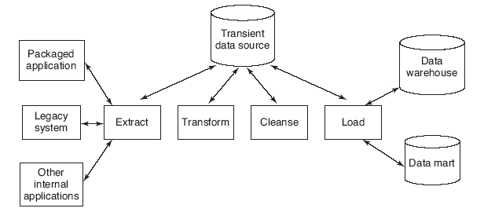
Data Integration and the
Extraction, Transformation, and Load (ETL) Process

Slide 13
Data Integration and the
Extraction, Transformation, and Load (ETL) Process
Issues affect whether an organization will purchase data transformation tools or build the transformation process itself
  Data transformation tools are expensive
  Data transformation tools may have a long learning curve
  It is difficult to measure how the IT organization is doing until it has learned to use the data transformation tools

Slide 14
Data Integration and the
Extraction, Transformation, and Load (ETL) Process
Important criteria in selecting an ETL tool
  Ability to read from and write to an unlimited number of data source architectures
  Automatic capturing and delivery of metadata
  A history of conforming to open standards
  An easy-to-use interface for the developer and the functional user

